Slide 1
Try It, Taste It, Tally It Up:
Fruit and Vegetable Challenge
Linda Carignan-Everts
EAP Wellness Coordinator

Slide 2
Make every bite count with the USDA Dietary Guidelines
1. Follow a healthy dietary pattern at every life stage.
2. Customize and enjoy nutrient-dense food and beverage choices to reflect personal preferences, cultural traditions, and budgetary considerations.
3. Focus on meeting food group needs with nutrient-dense foods and beverages and stay within calorie limits.
4. Limit foods and beverages higher in added sugars, saturated fat, and sodium, and limit alcoholic beverages.

Slide 3
Focus on meeting food group needs with nutrient-dense foods and beverages and stay within calorie limits.
The core elements that make up a healthy dietary pattern include:
Vegetables of all types—dark green; red and orange; beans, peas, and lentils; starchy; and other vegetables
• Fruits, especially whole fruit
• Grains, at least half of which are whole grain
• Dairy, including fat-free or low-fat milk, yogurt, and cheese, and/or lactose-free versions and fortified soy beverages and yogurt as alternatives
• Protein foods, including lean meats, poultry, and eggs; seafood; beans, peas, and lentils; and nuts, seeds, and soy products
• Oils, including vegetable oils and oils in food, such as seafood and nuts

Slide 4
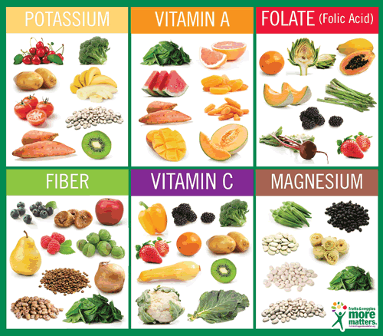
Key Nutrients in Fruits and Vegetables
Calcium
Fiber
Folate
Magnesium
Potassium
Vitamin A
Vitamin C

Slide 5
Where is the closest Farmer’s Market

Slide 6
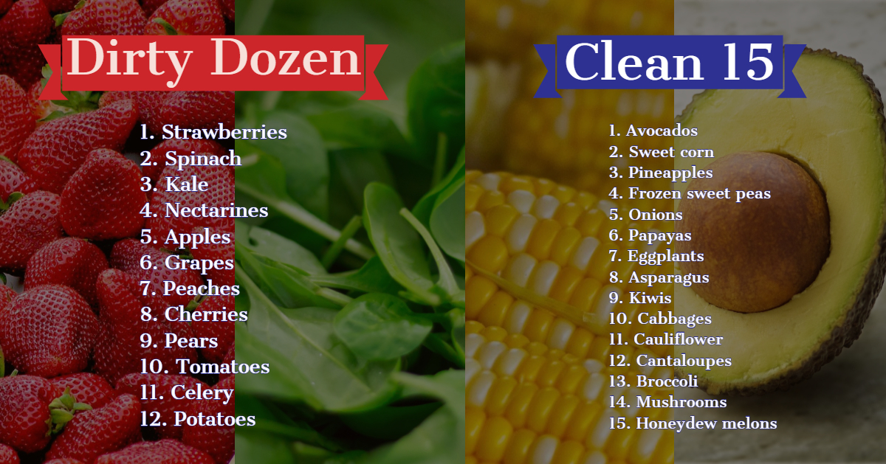

Slide 7
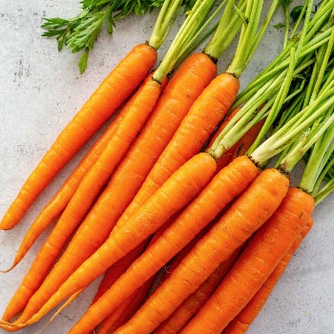
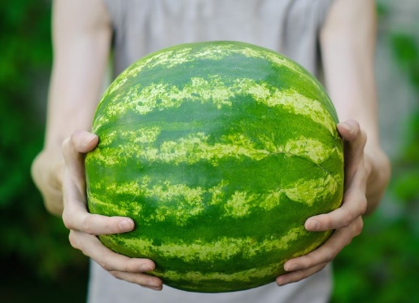
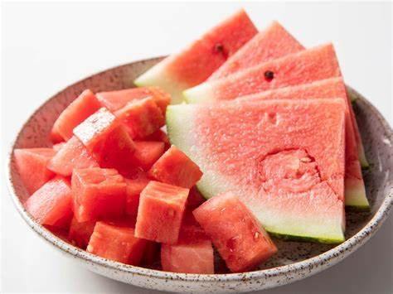
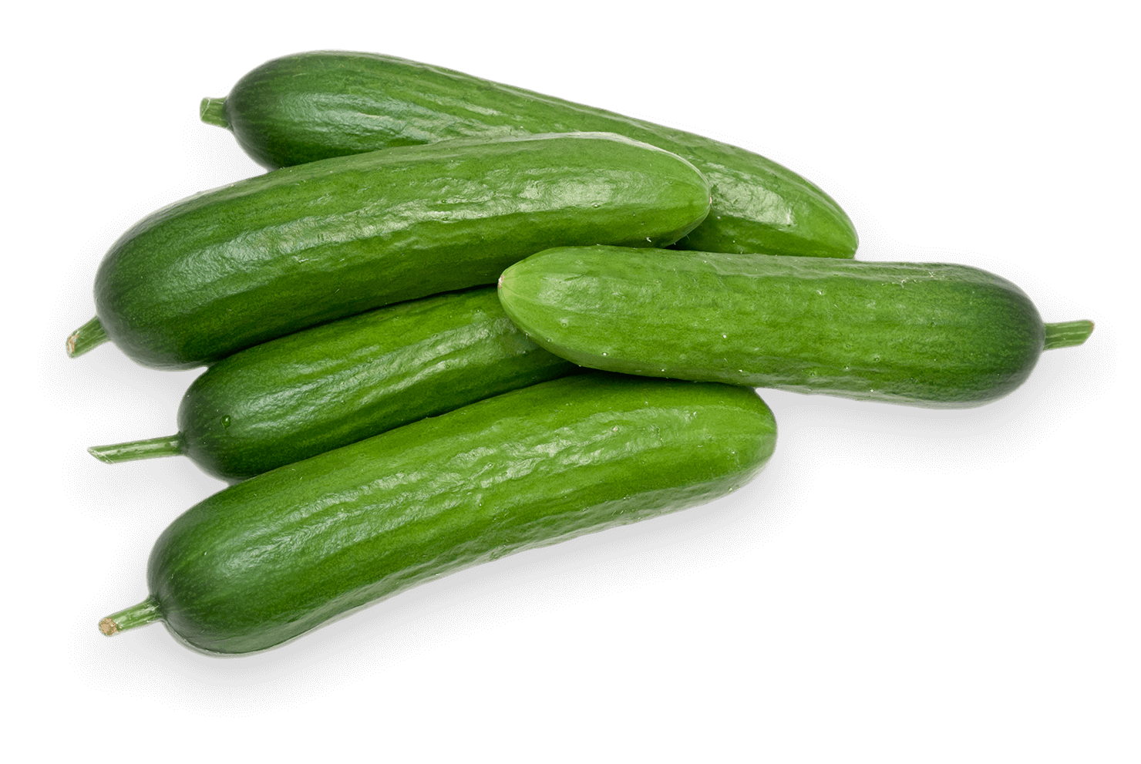
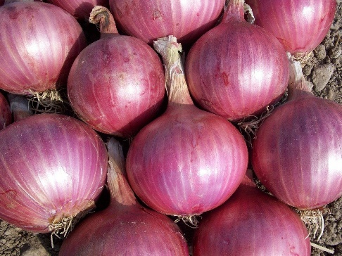
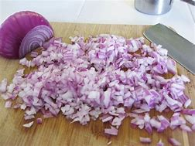
WellNYS Daily To-Dos
August 7: When you bring produce home from the store or farmer’s market, clean it well and cut it into serving pieces so if you are looking for a quick snack or preparing a meal the produce is ready to use.

Slide 8
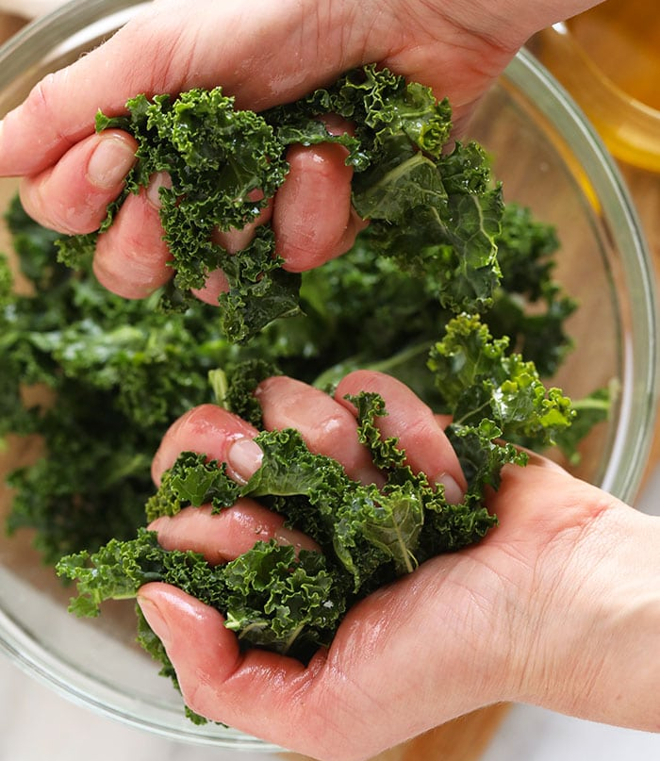
Kale
Kale is one of the most nutrient-dense foods, high in calcium, vitamin C, vitamin D, beta-carotene, and more. Drizzle some olive oil on kale and rub it with your hands until it has wilted, sprinkle on some salt and enjoy.

Slide 9
Fruit or Juice?

Slide 10
Grilling
Fruit Kabobs pineapple, watermelon, kiwi, strawberries, banana, nectarines

Slide 11
Grilling
Grilled Watermelon and Italian Sausage Kabobs

Slide 12
Grilling
Cherry and Pork Stewers and Cherry Rosemary Sauce
https://www.theproducemoms.com/2020/06/29/cherry-and-pork-skewers/

Slide 13
Grilling
Chicken and Lollipops Kabobs
https://www.theproducemoms.com/2018/05/09/chicken-and-lollipops-kabobs/

Slide 14
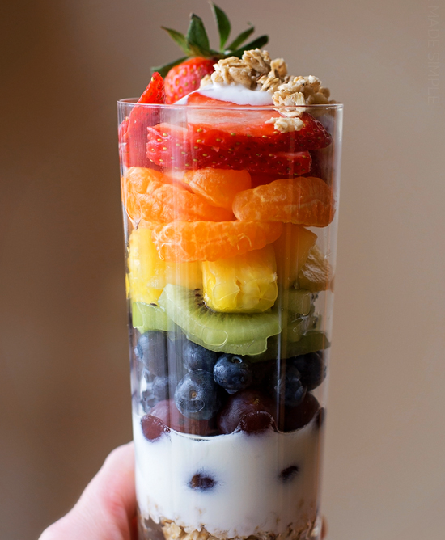
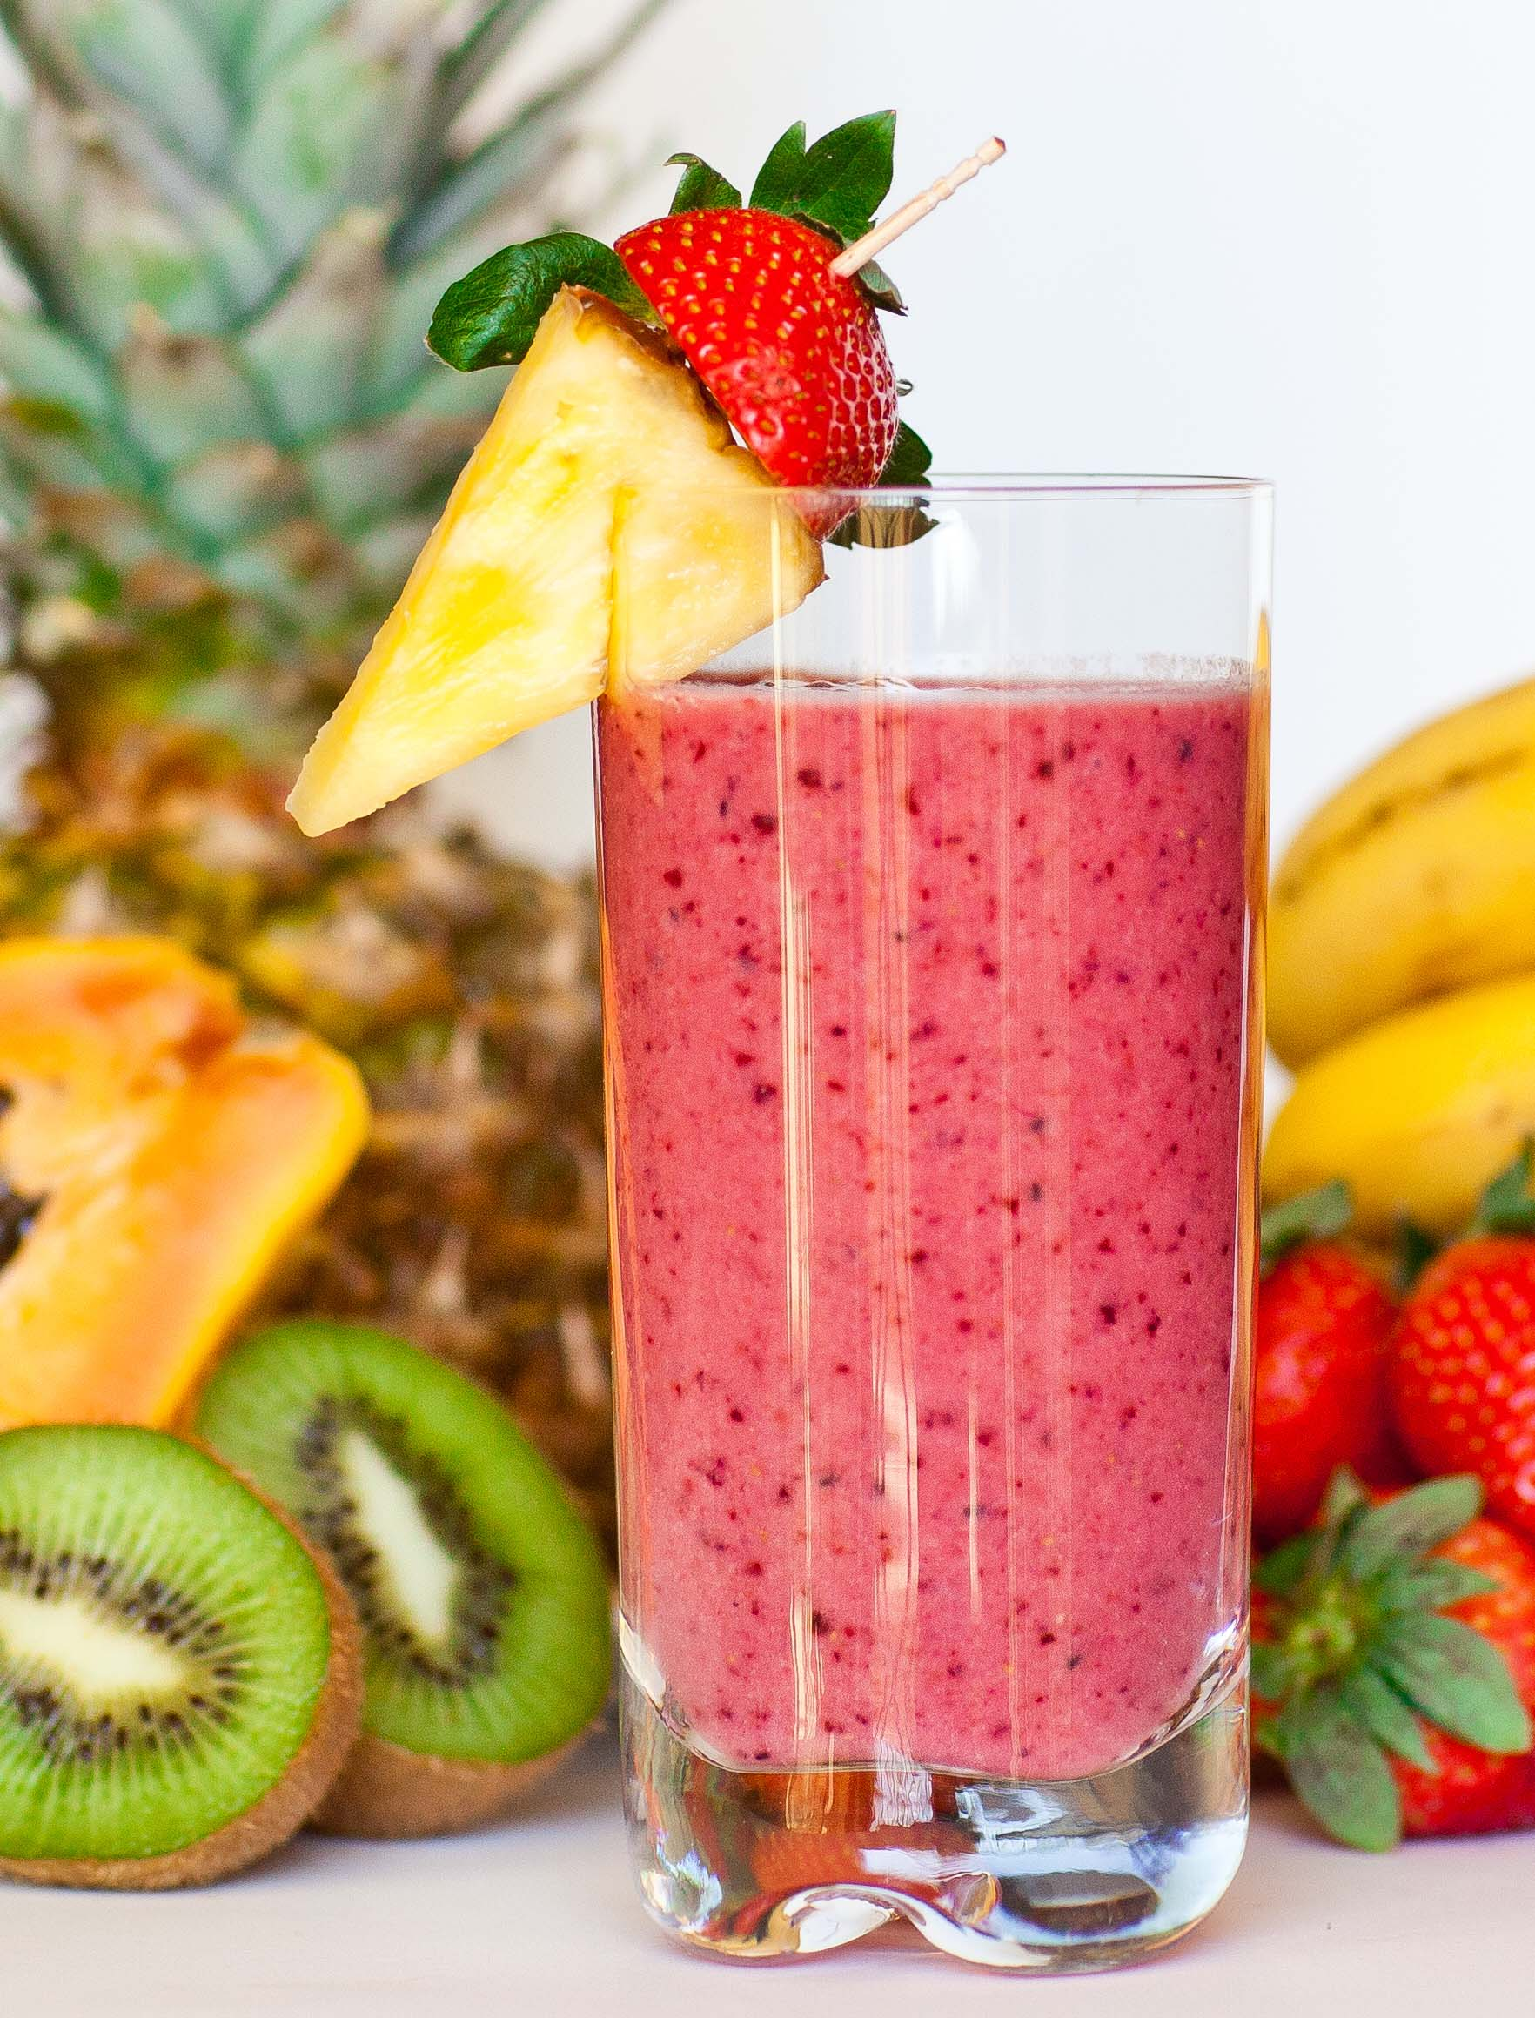
Fruit and Breakfast
In yogurt
On top of whole grain pancakes
In smoothies

Slide 15
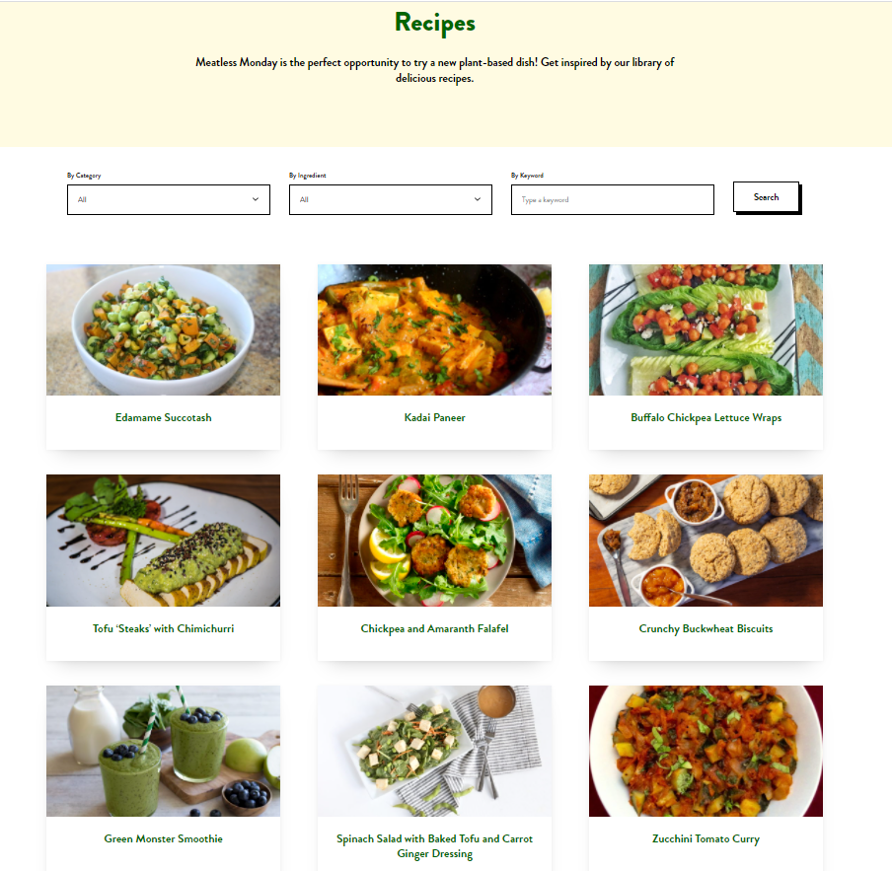
Meatless Mondays August 2, 9, 16, 23, 30
https://www.mondaycampaigns.org/meatless-monday

Slide 16
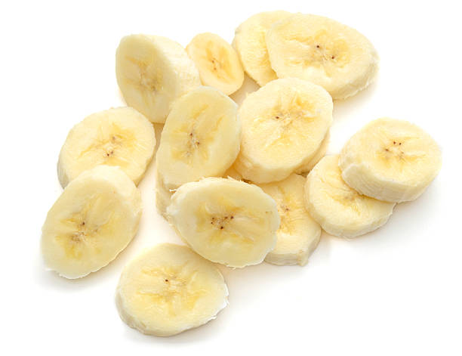
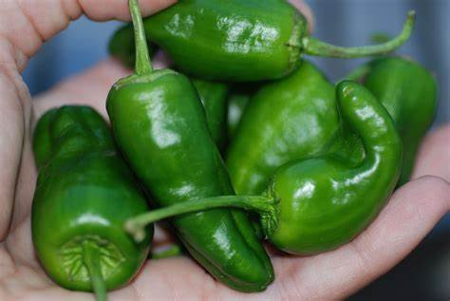
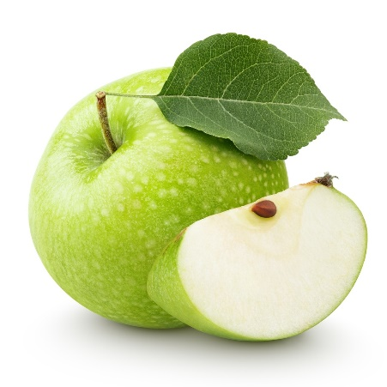
Describe the texture of your favorite fruit or vegetable
Juicy
Crunchy
Sweet
Soft
Cold
Sour
Spicey

Slide 17
August Fruit and Vegetable Challenge
Set a goal for August how many fruit and vegetables
Try it ….Taste it …Tally it Up …

Slide 18
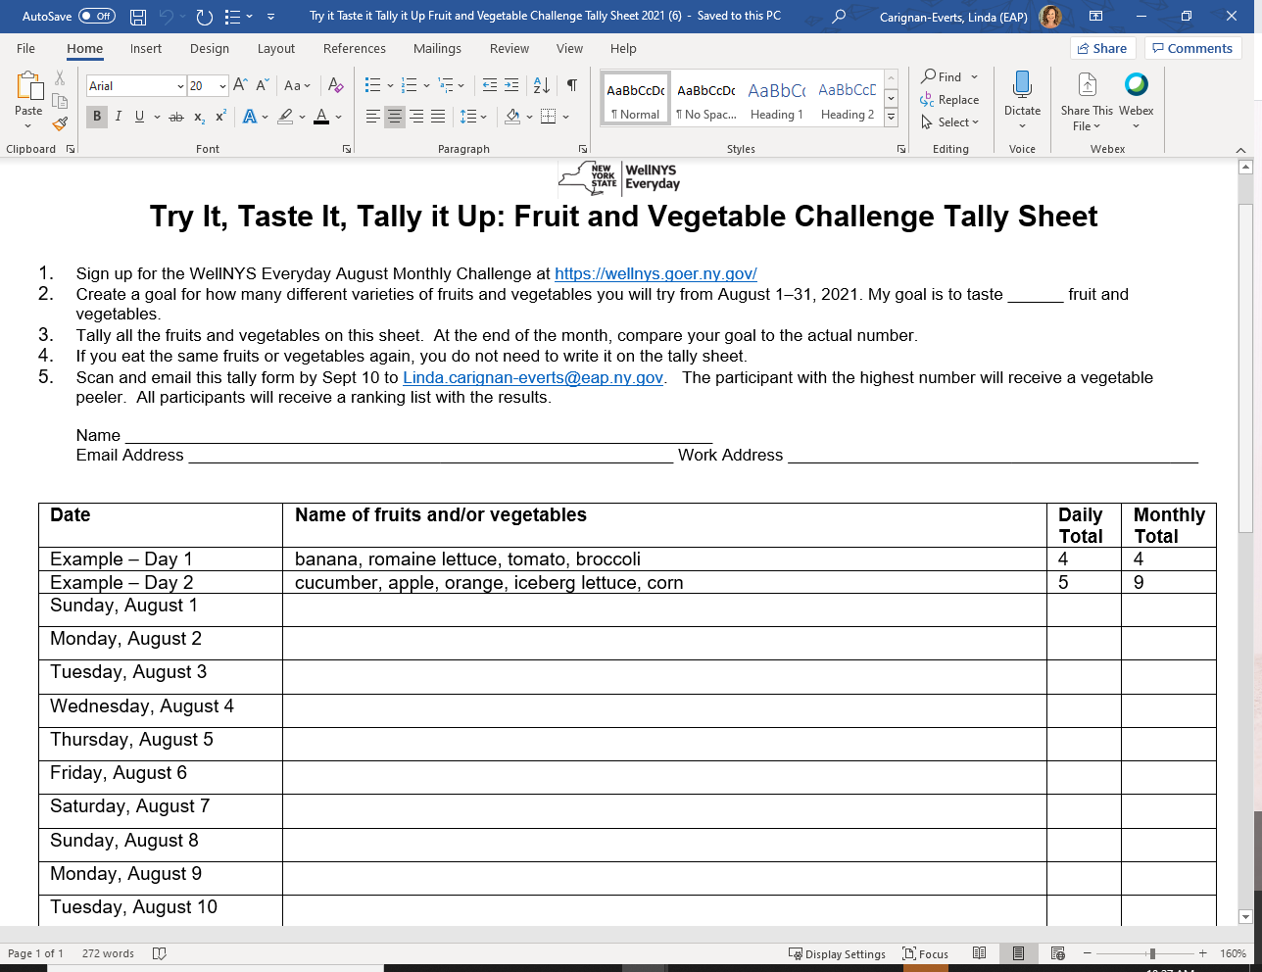
https://wellnys.goer.ny.gov/documents/wellness-resources/Try it Taste it Tally it Up Fruit and Vegetable Challenge Tally Sheet 2021.docx

Slide 19
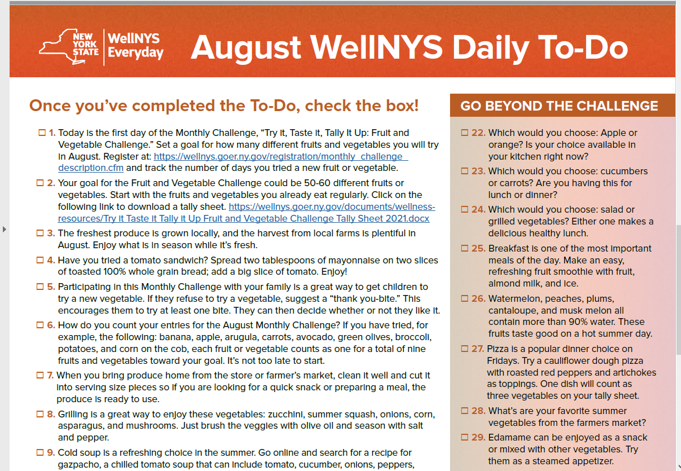

Slide 20
Are herbs considered a vegetable?
True or False?

Slide 21
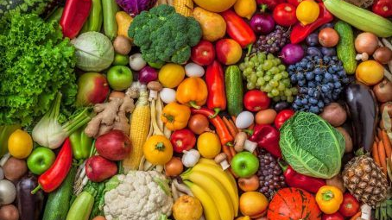
Try different varieties of fruits and vegetables

Slide 22
WellNYS Everyday
https://wellnys.goer.ny.gov

Slide 23
Talk to someone…
NYS employees, family member and retirees, if you are experiencing anxiety or other emotional distress, or if you just want to talk, please contact New York State Employee Assistance Program. EAP services are confidential, voluntary, and free.
1-800-822-0244 or visiting goer.ny.gov/find-eap-coordinator.
New York State Emotional Support Helpline or Project Hope provides free, confidential, 8am – 10pm, 7 days per week. 1-844-863-9314 or visit nyprojecthope.org.

Slide 24
EAP is a Program of Work-Life Services:
A Labor-Management Collaboration
Work-Life Services (WLS) Programs are joint labor-management programs that benefit New York State employees by enhancing employee wellbeing, increasing productivity, and improving morale in the workplace.
The WLS programs include the Employee Assistance Program, Network Child Care Centers, and DIRECTIONS: Pre-Retirement Planning. The WLS programs are funded through the collective bargaining agreements between the State of New York and the public employee unions: CSEA, PEF, UUP, NYSCOPBA, GSEU, Council 82, and DC-37. The Governor’s Office of Employee Relations contributes on behalf of management/confidential employees.

Slide 25
Resources
WellNYS Everyday https://wellnys.goer.ny.gov/
WebMD
Fruits and Veggies https://fruitsandveggies.org/
Medicalnewstoday.com
USDA https://www.usda.gov/

Slide 26
Thank you!
Please share something you learned today with a family member or friend. If you have any questions, here is my information:
Linda Carignan-Everts
EAP Wellness Coordinator
Linda.Carignan-Everts@eap.ny.gov

